Slide 1
Submodel Template Description

Slide 2
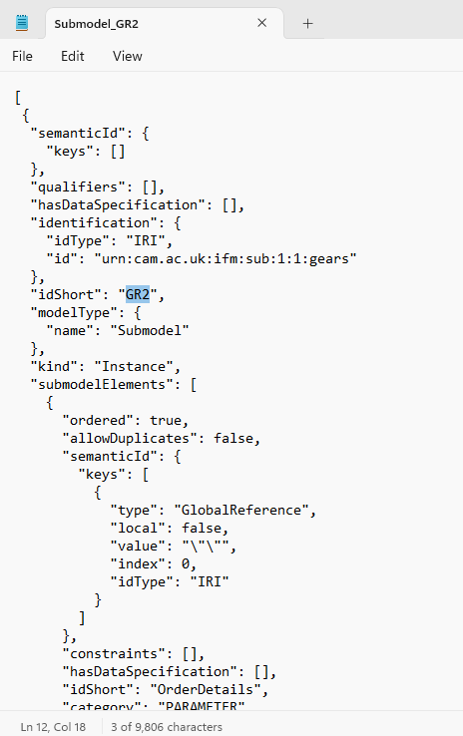
1. The ids of the parts are located here in the JSON file
Parts | IDs
Gears | GR2
Casing | CS1
Screws | SR3
Plastic lid | PL1
So the folder sent contains templates for 4 submodels, each with a unique id for each part

Slide 3
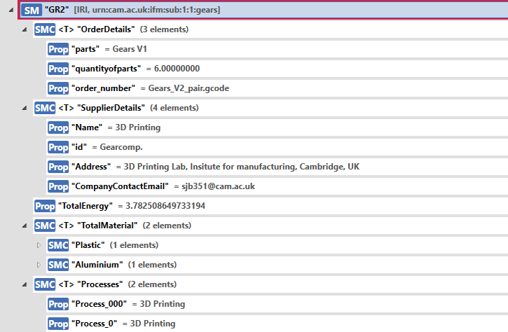
GEARS submodel structure

Slide 4
2. The data to be edited by the supplier are
1
In Order Details
parts : name of the parts
Quantity of parts
Order number: internal for the supplier

Slide 5
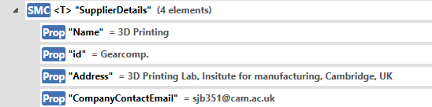
2. The data to be edited by the supplier are
2
In Supplier Details
Name : name of the supplier company
Address: address of the supplier company
Company contact email
DO NOT CHANGE THE ‘ID’ FIELD. THIS IS INTERNAL TO THE OEM

Slide 6
2. The data to be edited by the supplier are
3
Total energy consumed for manufacturing the order

Slide 7
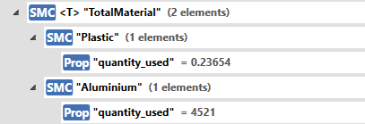
2. The data to be edited by the supplier are
4
In Total Material
The name of the material used and under it the quantity used. In the description field also the unit could be specified

Slide 8

2. The data to be edited by the supplier are
5
In Processes
The key could be the order of the process, for example Process_1, Process_2, etc. and the value could be what the process is eg: drilling, 3d printing, etc.

